Slide 1

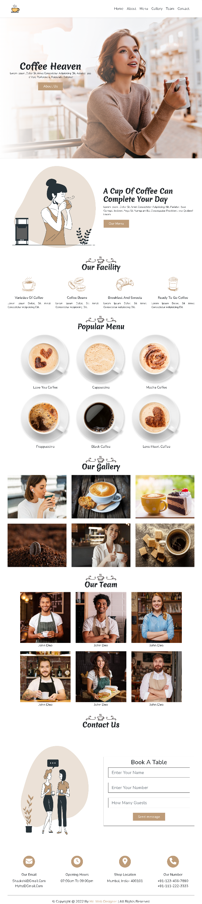
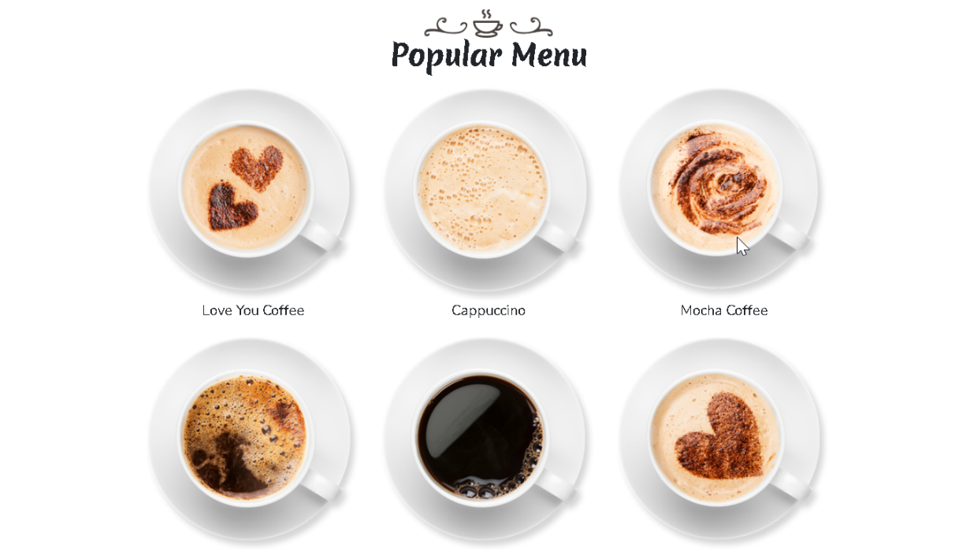


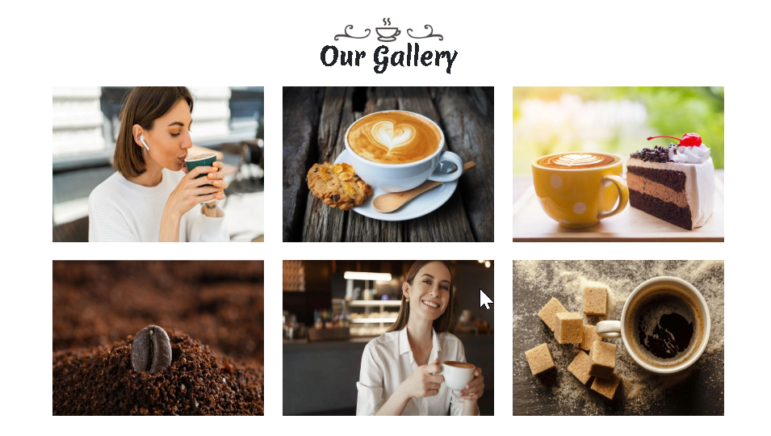
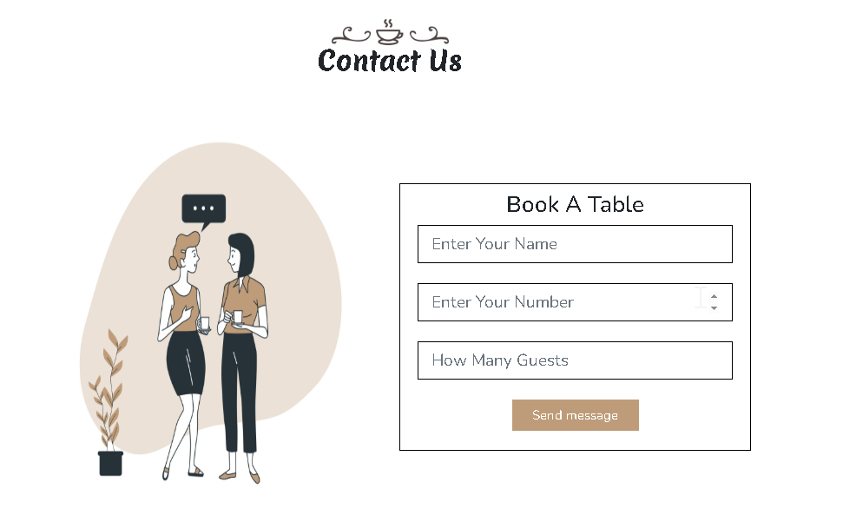
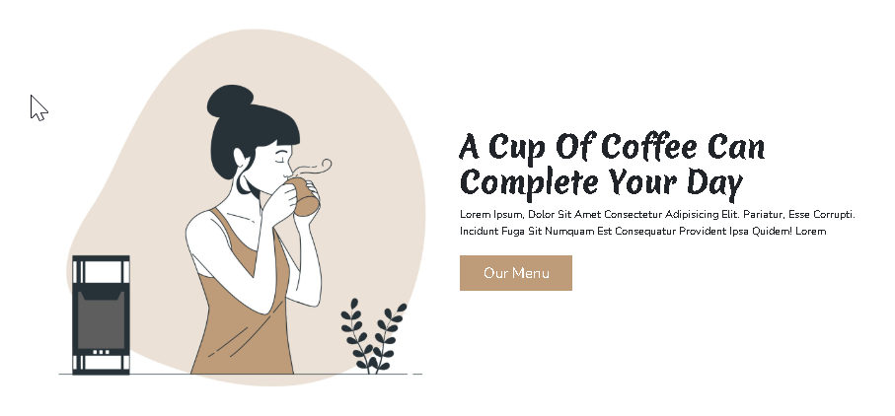
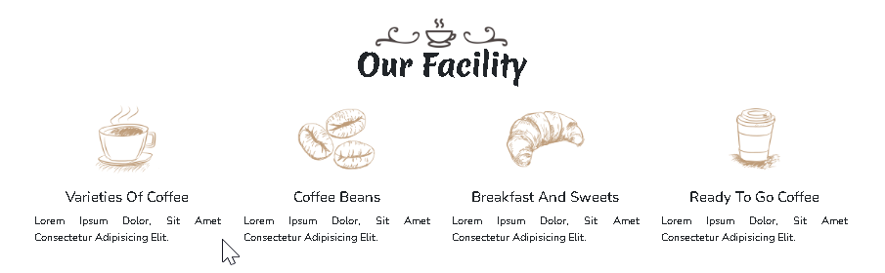
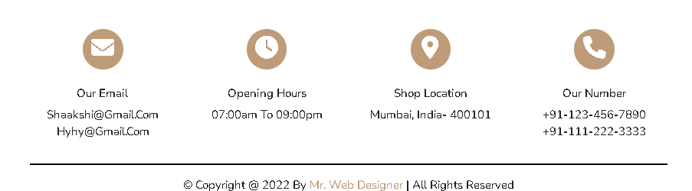
coffeeshop_website (Components)
1_navBar
9
2_hero
5_popular
7_team
3_ourMenu
6_gallery
8_contact
4_facility
9_contactIcons

Slide 2
coffeeshop_website (Components)
1_navBar
component

Slide 3
coffeeshop_website (Components)
1_navBar
row

Slide 4
coffeeshop_website (Components)
1_navBar
column

Slide 5
coffeeshop_website (Components)
1_navBar
subColumn

Slide 6
coffeeshop_website (Components)
2_hero
component

Slide 7
coffeeshop_website (Components)
2_hero
row

Slide 8
coffeeshop_website (Components)
2_hero
column

Slide 9
coffeeshop_website (Components)
2_hero
subColumn

Slide 10
coffeeshop_website (Components)
3_ourMenu
component

Slide 11
coffeeshop_website (Components)
3_ourMenu
row

Slide 12
coffeeshop_website (Components)
3_ourMenu
column

Slide 13
coffeeshop_website (Components)
3_ourMenu
subColumn

Slide 14
coffeeshop_website (Components)
4_facility
component

Slide 15
coffeeshop_website (Components)
4_facility
row

Slide 16
coffeeshop_website (Components)
4_facility
column

Slide 17
coffeeshop_website (Components)
4_facility
subColumn

Slide 18
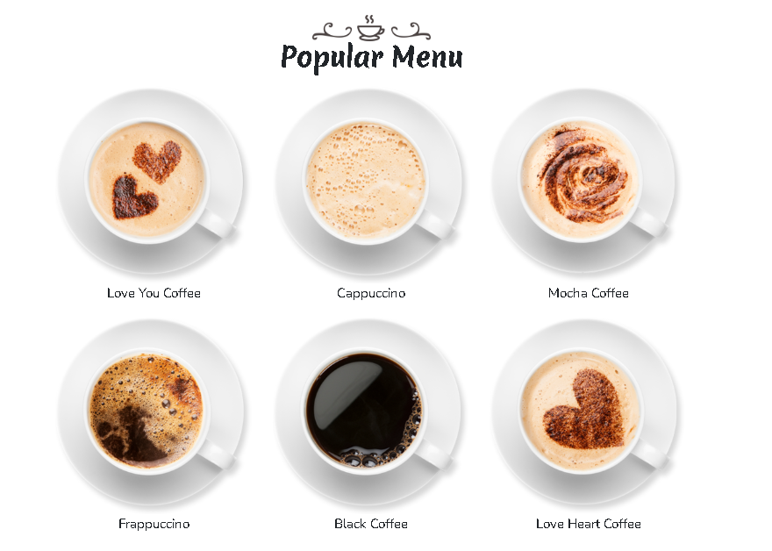
coffeeshop_website (Components)
5_popular
component

Slide 19
coffeeshop_website (Components)
5_popular
row

Slide 20
coffeeshop_website (Components)
5_popular
column

Slide 21
coffeeshop_website (Components)
5_popular
subColumn

Slide 22
coffeeshop_website (Components)
6_gallery
component

Slide 23
coffeeshop_website (Components)
6_gallery
row

Slide 24
coffeeshop_website (Components)
6_gallery
column

Slide 25
coffeeshop_website (Components)
6_gallery
subColumn

Slide 26
coffeeshop_website (Components)
7_team
component

Slide 27
coffeeshop_website (Components)
7_team
row

Slide 28
coffeeshop_website (Components)
7_team
column

Slide 29
coffeeshop_website (Components)
7_team
subColumn

Slide 30
coffeeshop_website (Components)
8_contact
8 of 9
component

Slide 31
coffeeshop_website (Components)
8_contact
17 of 19
row

Slide 32
coffeeshop_website (Components)
8_contact
17 of 19
column

Slide 33
coffeeshop_website (Components)
8_contact
17 of 19
subColumn

Slide 34
coffeeshop_website (Components)
9_contactIcons
component

Slide 35
coffeeshop_website (Components)
9_contactIcons
row

Slide 36
coffeeshop_website (Components)
9_contactIcons
column

Slide 37
coffeeshop_website (Components)
9_contactIcons
subColumn

